Slide 1
Saint Monitor2 User Guide
July 2008

Slide 2
Contents
What does the Monitor2 do?
Buttons and Menus

Slide 3
What does the Monitor2 do?
Saint Monitor2 is an application that interfaces with the Saint Bus Engine2 to display serial bus communications (see figure on next page)
Saint Bus Engine 2 (SBE2) receives data from products on the USB or Serial ports of the PC and makes it available to any user created applications such as the Saint Monitor2
Saint Monitor2 can be used for product development, IT&V testing, and many other bench needs
  Serial Bus Monitoring
  Product Emulation
  Bus Traffic Logging
  Message Decoding

Slide 4
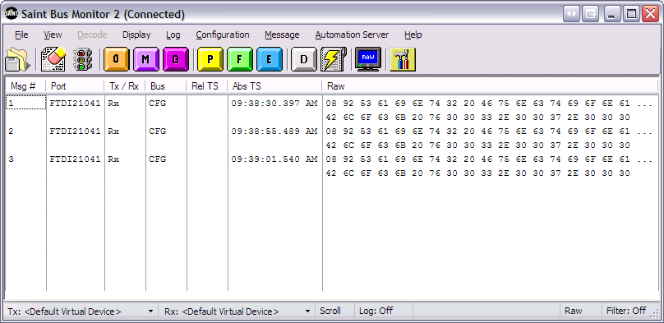
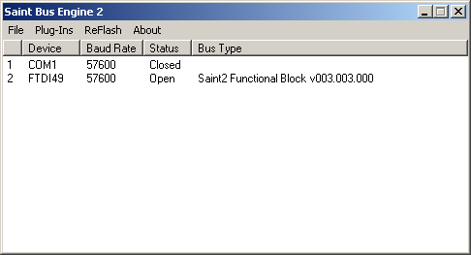



Saint Monitor2 flow diagram
Serial Bus Data
Bus to USB

Slide 5
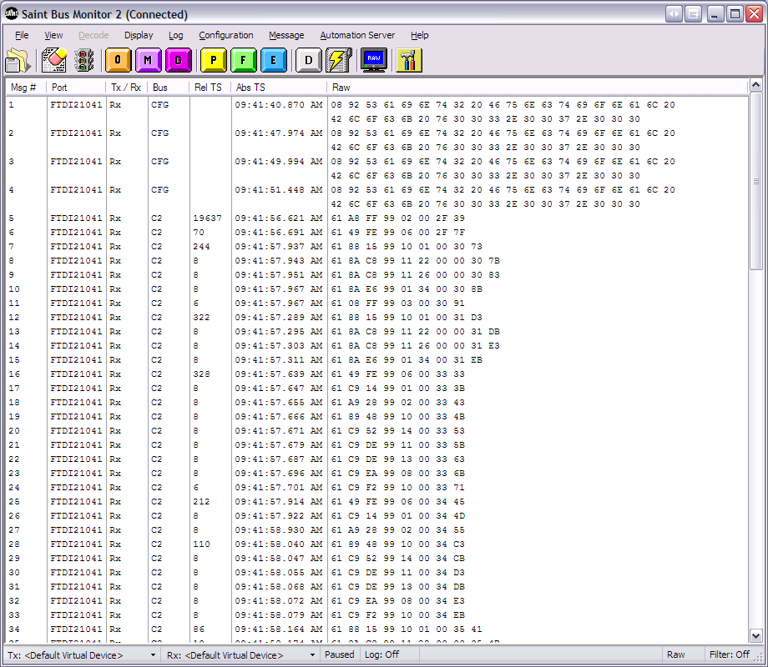
Serial Bus Monitoring
Serial Bus Traffic which could be from products such as a radio, HVAC unit, Cluster, etc.

Slide 6
Product Emulation
The SaintMonitor2 can be used to emulate a product
  How?
    Periodic Messages
      Could be used to send keep alive message
    Emulation feature (explained later)
      Can be used to send response messages after receiving specific “trigger message”
  Often done by connecting two SAINT units together

Slide 7
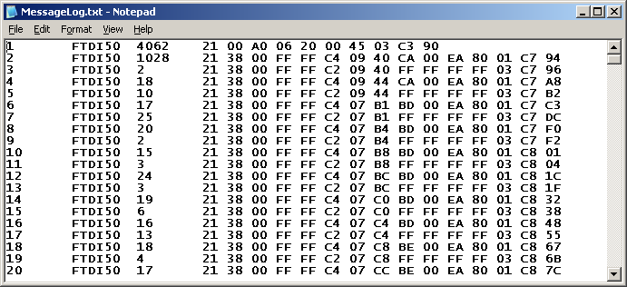
Serial Bus Traffic Logging
Can log bus traffic for extended periods of time to try and locate hard to find events

Slide 8
Message Decoding
Raw Hex Messages can be converted to more readable formats through:
  Hex to ASCII decoding
  Predefined sequences
  Custom decoding files

Slide 9
Buttons and Menus

Slide 10
File Menu
Save Buffer To File
  Saint Monitor2 holds a specific amount of messages in a buffer which are displayed in the window
  Save Buffer to File dumps the entire buffer (default 10k messages) to a file specified by the user
Load/Save Workspace
  Allows the user to load/save all settings associated with the Monitor
Exit

Slide 11
View Menu
Toolbar
  The toolbar that holds all the buttons on the main form
Status Bar
  The information displayed on the very bottom of the form (Tx S2, Rx S2, Scroll, Raw, etc.)
Message File
  If a message file (described later) is loaded then it allows user to determine whether or not it is displayed
Options
  Allows the user to customize the parameters of the Saint Bus Monitor
Find Message
  Allows the user to search bytes of message traffic while paused

Slide 12
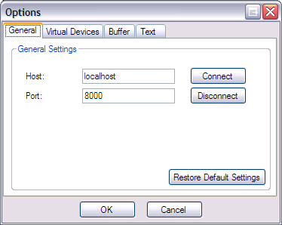
View Menu->Options->General
Server Settings
Determines where Monitor looks for Saint Bus Engine2 (SBE2)
Determines what port to connect to SBE2

Slide 13
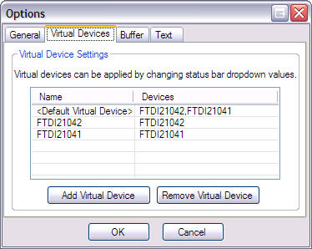
View Menu->Options->Virtual Devices
Shows all devices as seen by Saint Bus Engine
Virtual device allows user to send messages to multiple devices
  Add devices to virtual device
  When sending messages choose virtual device and message gets sent to all SAINTs associated with virtual device
Click in lower left status bar to set Tx\Rx Saint

Slide 14
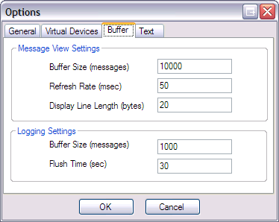
View Menu->Options->Buffer
Msg View - Buffer Size
  Specifies the max size of a circular buffer used to store messages (1,000 to 1,000,000)
Msg View - Refresh Rate
  Rate at which message view is upated
Msg View -Display Line Length
  # of bytes/line (5 – 100)

Slide 15
View Menu->Options->Buffer
Log Settings - Buffer Size
  Specifies the max size of a circular buffer used to store the log history before writing to a file (100 to 1,000,000)
Log Settings - Flush Time
  Max time allowed between each write to the log file (0 – 3,600)

Slide 16
Display Menu
Pause/Resume
  Starts/Stops the flow of messages across the monitor screen
Clear
  Erases all messages seen on the screen

Slide 17
Display Menu (cont.)
Mode
  Messages can be displayed in 3 different formats
    Raw
      Hex view of messages
    Short
      Saint format bytes removed (header, FF 00 end sequence, completion code)
    Decode
      Certain buses such as class2 and CAN have predetermined message meanings, which will be inserted in place of hex bytes (e.g. class2 power mode messages)

Slide 18
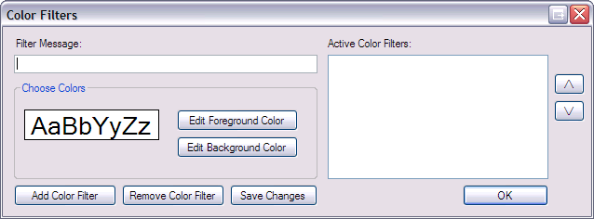
Display Menu (cont.) Color Filters
Ability to add color to specific message sequences
Aids in separating certain messages from others

Slide 19
Log Menu
Gives user ability to log all data to a specified file location in choice of three formats
  Raw Data
    Hex view of messages
  Decoded Data
    Formatted data view (ASCII text, replaced values, etc.)
  Short Data
    Similar to Raw view, but S2 Header, completion code and time stamps are removed

Slide 20
Configuration
Reset
  Sends a reset command to Saint/Saint2 unit
Get Version
  Sends a firmware version request to Saint/Saint2
  Returns hex string of current software version residing in hardware
Time Stamp
  Toggle on\off the return of 2 byte time stamp from S2
Echo Transmit
  Toggle whether or not transmitted messages are echoed back to the host (S1 only)

Slide 21
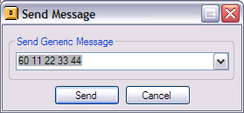
Message Menu->Generic Message
Gives user ability to send unformatted generic message

Slide 22
Message Menu->Message File
Message files allow a user to have a list of messages entered in a text file (*.msg) that are often used in testing
  Alleviates need to keep typing in the same messages
  Message files are displayed in the Message File window (bottom of form), can be turned off
  User can double-click the message in the message file, and it will then be sent out by the Saint Monitor2

Slide 23
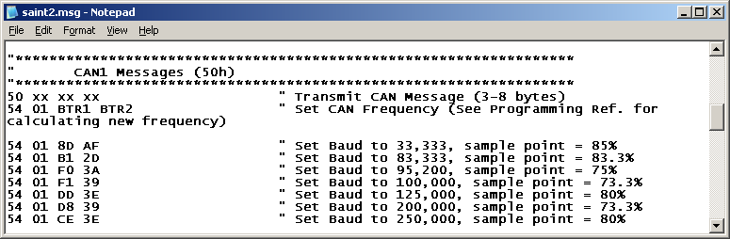
Message Menu->Message File (cont.)
Sample Message File

Slide 24
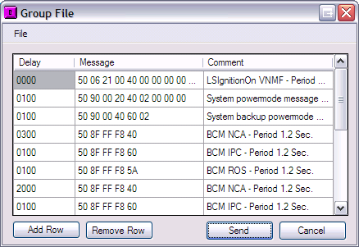
Message Menu->Group File
Group File
  Opens dialog box to select group file (*.grp)
  Group File format
    XXXX Msg1 “comment
    XXXX Msg2
    …
    XXXX MsgN
  XXXX = time delta (ms)

Slide 25
Message Menu->Group File (cont.)
Group files allow the user to send messages in specific time increments
  For example, if something needs to be sent in millisecond timing then it would be all but impossible for a user to type in a message and click the send button fast enough. Enter group files
Group File can be created, edited, saved from Group File dialog

Slide 26
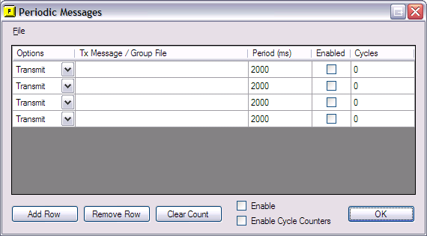
Message Menu->Periodic Messages
Allows user to setup periodic messages on certain time intervals
Allows user to setup periodic group file on certain time intervals
  Make sure that ‘Group File’ is chosen in the options column

Slide 27
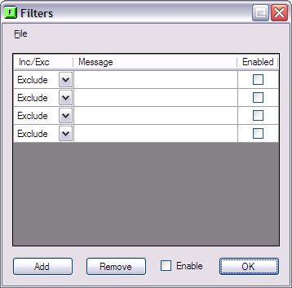
Message Menu->Filter
Allows user to view certain subsets of incoming messages
  Include Option
    Monitor will only display messages matching given message sequence
  Exclude Option
    Monitor will not display messages matching given message sequence
  WildCards
    X – don’t care nibble
    x – don’t care bit
    See help for examples

Slide 28
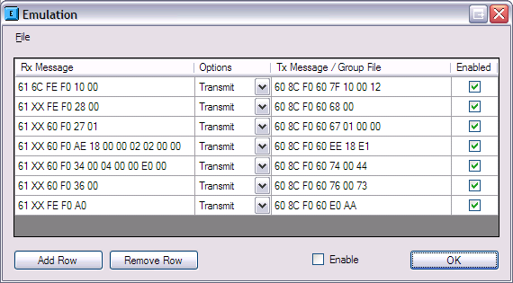
Message Menu->Emulation
Enter message to watch for
Enter response message

Slide 29
Message Menu->Emulation (cont.)
Gives ability to automatically respond to incoming messages with either group files or single messages
Great for emulating a product’s actions with a second SAINT unit
WildCards – Just like Filters
  X – don’t care nibble
  x – don’t care bit
  See help for examples

Slide 30
Message Menu->Definition File
Allows user to load custom decode files (.xml) or decode source (.cmd) files
When user selects this menu option a dialog box is launched to locate the .cmd or .xml file to load
Decode files are first converted from .cmd files to .xml files
See separate document on website for more explanation

Slide 31
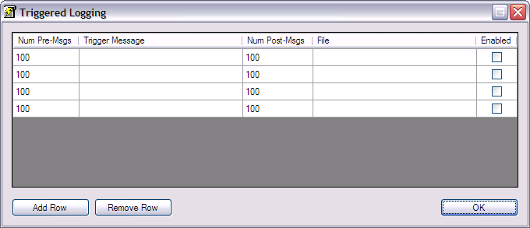
Message Menu->Triggered Logging
Allows user to specify a Trigger message to start logging
User can specify the number of messages to log before and after the trigger message

Slide 32
Message Menu-> Triggered Logging (cont)
Upon finding trigger message, SBM2 saves X number of messages before trigger message and Y number of messages after
  X, Y and trigger messages are all set by user
Very useful when trying to look for certain events that have a low frequency of occurrence
Results saved to predetermined location in txt or html format
Filter (X,x)

Slide 33
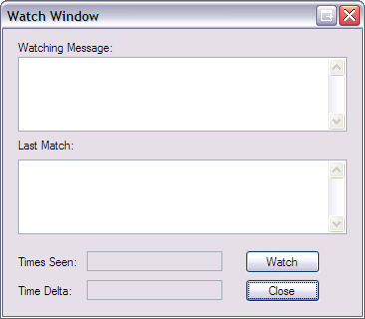
Message->Watch Window
Message watch allows users to observe a set of messages around a certain defined event
Useful for capturing events that are hard to find

Slide 34
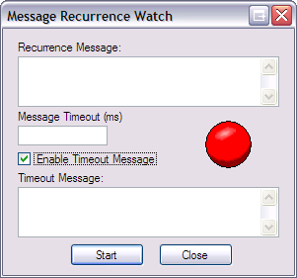
Message->Message Recurrence Watch Window
Allows users to monitor specific message for periodic recurrenace
Useful for monitoring State-of-Health messages
User defined message can be sent on Timeout

Slide 35
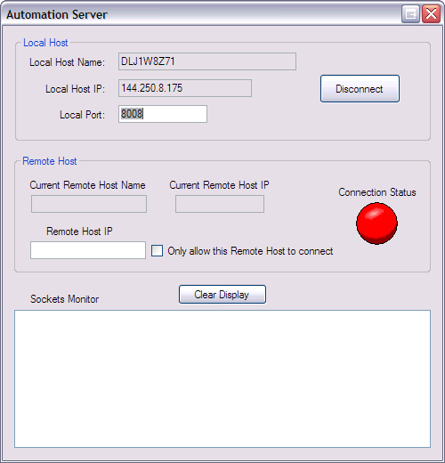
Automation Server Menu
Automation Server
  Allows other programs to control Saint Monitor2
  Other programs can remotely execute commands
  Can be configured to only allow specific remote hosts

Slide 36
Toolbar

Slide 37
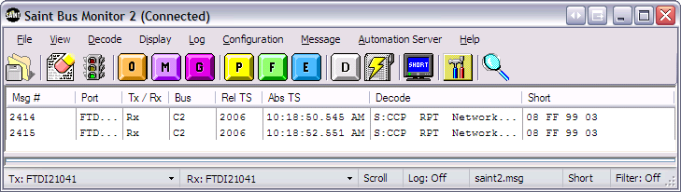
Toolbar->Erase
Erase button allows user to clear the screen from all messages
Erase Button

Slide 38
Toolbar->StopLight
Pauses/Resumes message flow on screen
  Useful to look at specific messages on fast bus traffic
Pause/Resume

Slide 39
Toolbar->SendButton
This button pops up a dialog box to allow user to send a message
  Make sure the device is set to the correct SAINT device before sending message
Send Button

Slide 40
Toolbar->Message File
Opens dialog box to select a message file
  As defined earlier in this document a message file is used for quick access to commonly used messages
Message File

Slide 41
Toolbar->GroupFile
Group File button allows user to send a group file
Dialog box is opened to select specific group file
After send is clicked all messages will be sent out according to timing parameters
Group File

Slide 42
Toolbar->Periodic
Periodic Button opens dialog box to setup periodic messages
  Rate
  Message
  Device
  Enabled
Periodic Button

Slide 43
Toolbar->Filter
Filter Button will open the Filter dialog box
Allows user to monitor only subsets of incoming message traffic
Filter

Slide 44
Toolbar->Emulation
Opens dialog box to emulation dialog
Allows user to setup specific responses to certain messages
Emulation

Slide 45
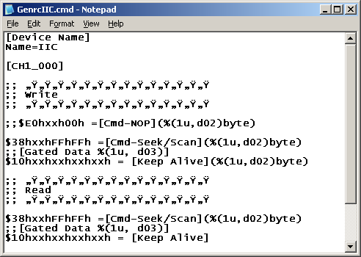
Toolbar->Custom Decode (cont.)
What is a custom Decode file?
.cmd file defines messages the user wants decoded
Additional documentation is available to create .cmd files on website
CMD files then converted to XML

Slide 46
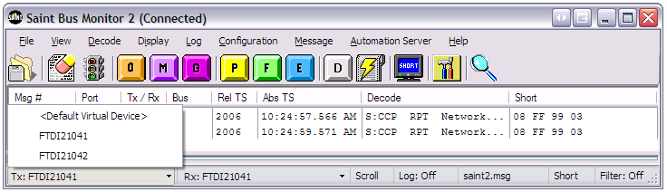
Connections
Click task bar to specify Tx\Rx Saint2
Gives ability to connect to all or just certain units

Slide 47
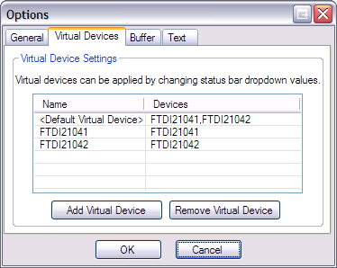
Connections
Double click taskbar to open Virtual Devices dialog
  Gives user the ability to connect to multiple Saints simultaneously

Slide 48
Toolbar->Decode
Indicates the current decode option (raw, short, decode)
User can click to change between the 3 modes
Decode State

Slide 49
Toolbar->Find
Allows the user to search for a specific message
Only Works while paused
Find

Slide 50
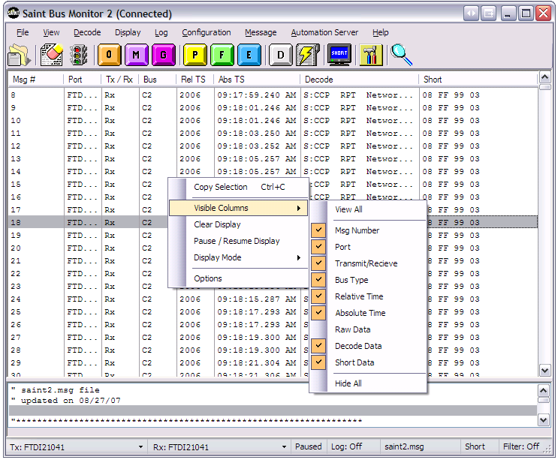
Custom Columns
Find

Slide 51
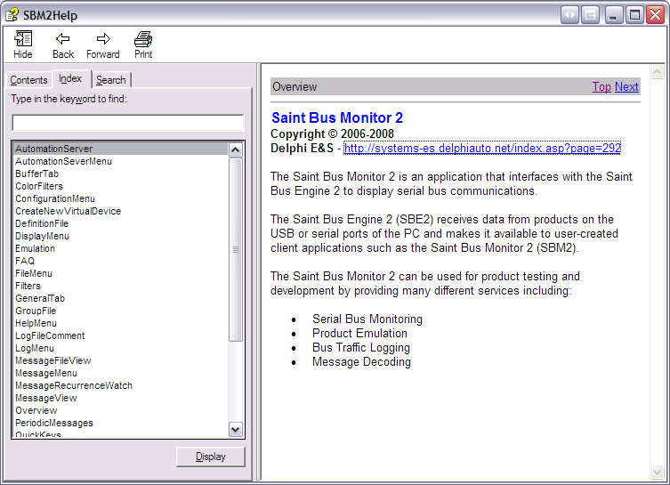
Help
Online Help
Saint2 WebSite
  http://systems-es.delphiauto.net/index.asp?page=292
“F1” context help

